Slide 1
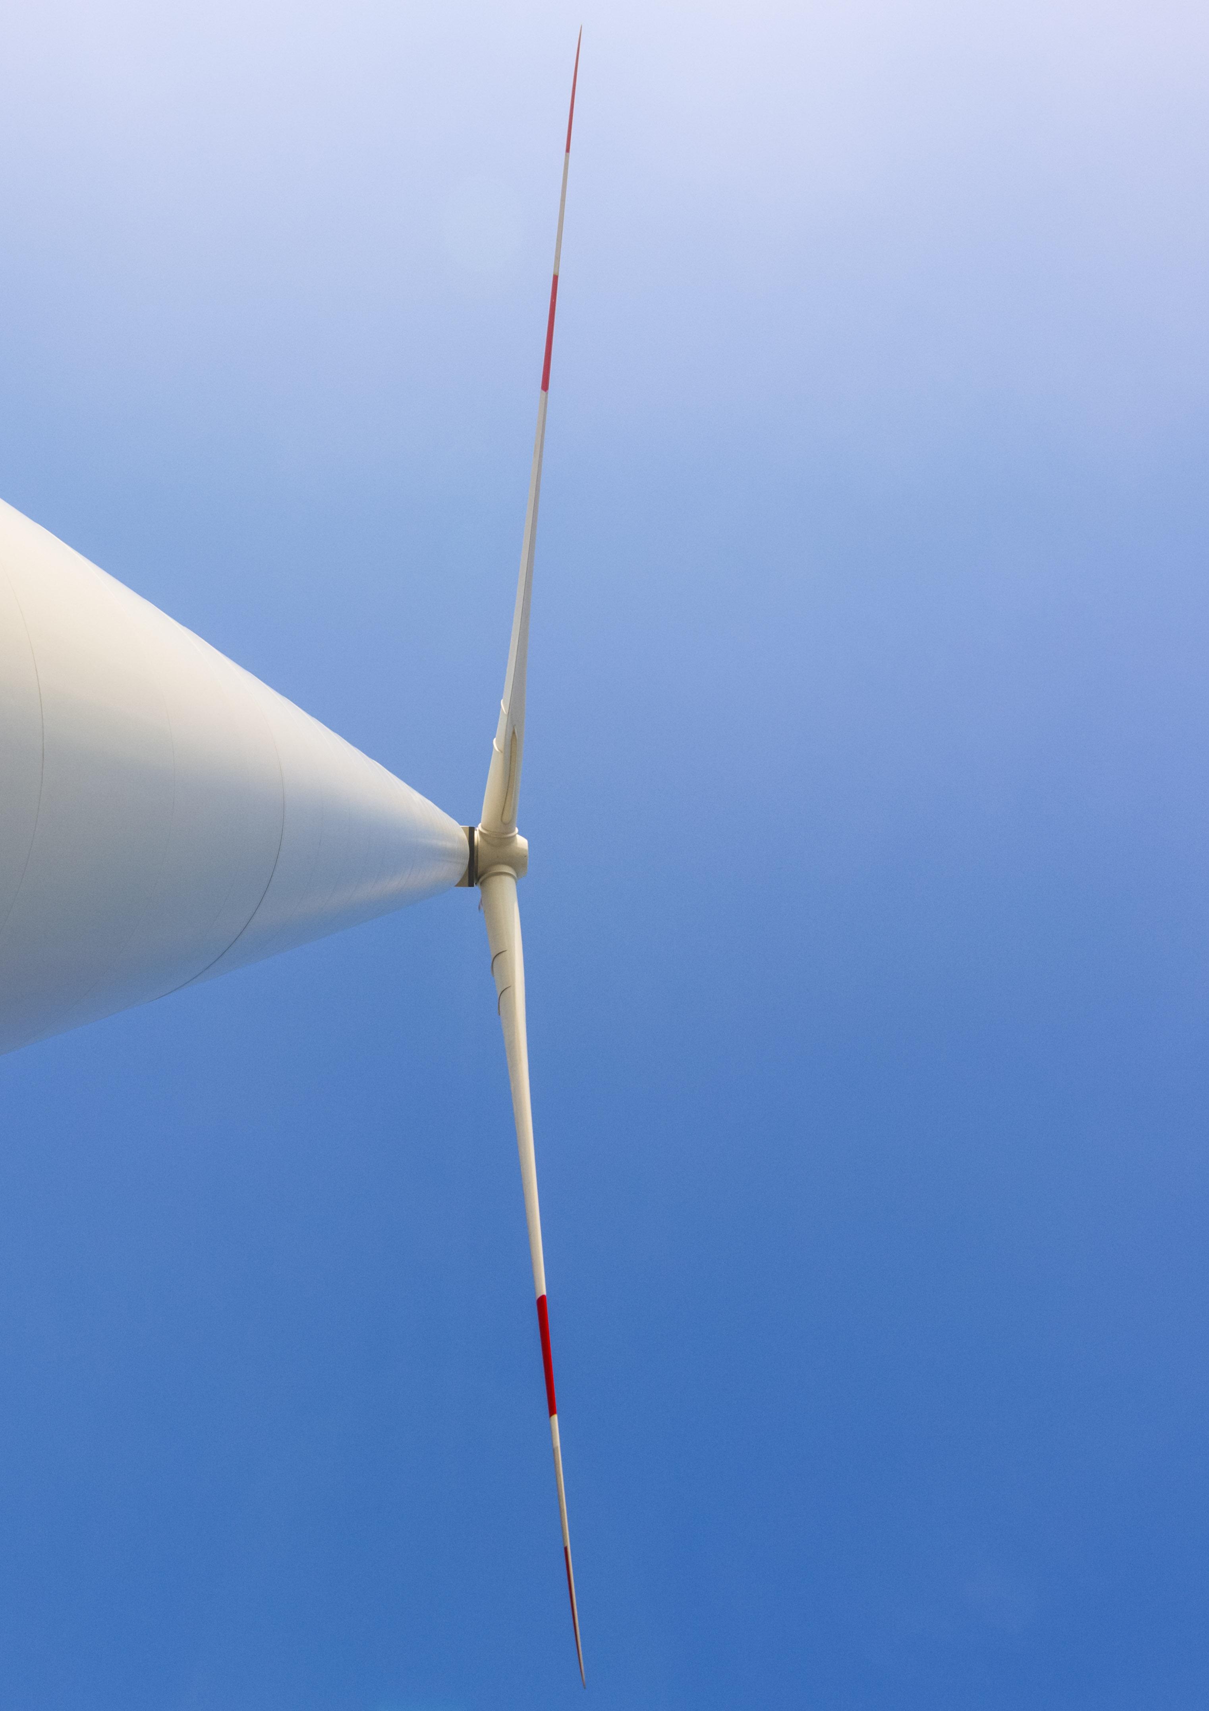

lecture series
SoSe 2021
lecture series
03.05. Symbolic Flexible Multibody Models for Wind Turbine Controller Design and Analysis
Prof. Dr.-Ing. Jens Geisler, Hochschule Flensburg
31.05. Lobbying for wind energy in Schleswig-Holstein: The workings of a political association in the wind energy sector
Kristina Clemens, Bundesverband WindEnergie
07.06. Secondary effects of a modified wind turbine with open blade tips
Prof. Dr.-Ing. habil. Bodo Fiedler, Hamburg University of Technology
14.06. DLR Forschungspark Windenergie
Lukas Firmhofer, Deutsches Zentrum für Luft- und Raumfahrt
21.06. Certification for Floating Offshore Wind
Andreas Manjock, Principal Engineer and Offshore Project Manager, Loads Team Hamburg, Renewables Certification, DNV GL - Energy
each 6 pm
online with WebEx
accesses and more information:
https://hs-flensburg.de/forschung/fue/forschungsinstitute/wind-energy-technology-institute

